Slide 1
Lesson 3 Gyro
Can you determine the direction of this presentation?
Ben Schwarz

Slide 2
Introduction
It can be helpful sometimes do know directional information on your robot.
Where gyros come in handy.
This will teach you how to use a gyro.
But what gyro can we use on our robot?

Slide 3
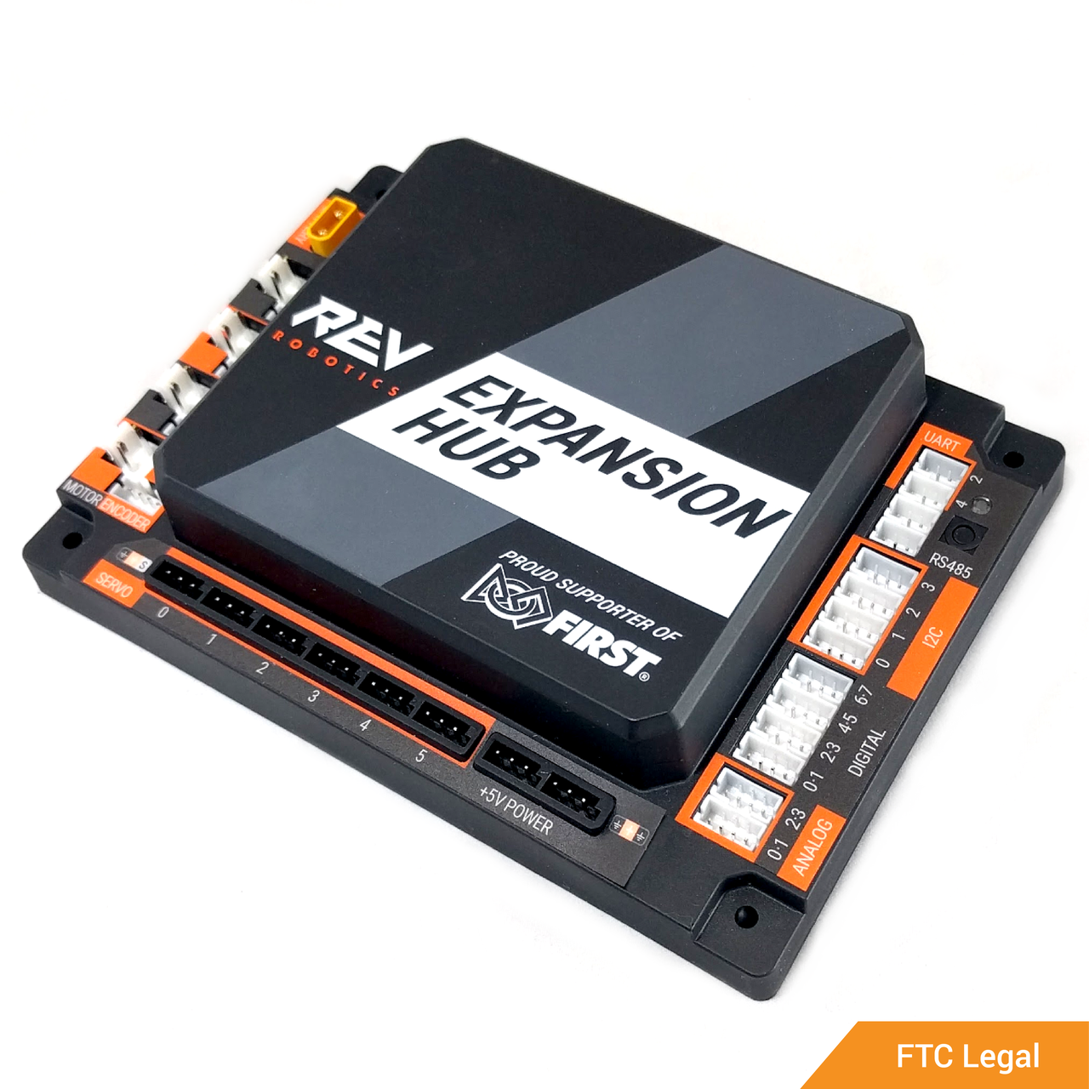
Enter the REV Expansion Hub Inertial Measurement Unit (IMU)
Able to give you information that you want (like 3 axis rotational information)
Able to give you information with questionable relevance to ftc (like temperature, though I haven’t tested it)

Slide 4
What it can measure
Absolute Orientation (Euler Vector, 100Hz) Three axis orientation data based on a 360° sphere
Absolute Orientation (Quaterion, 100Hz) Four point quaternion output for more accurate data manipulation
Angular Velocity Vector (100Hz) Three axis of 'rotation speed' in rad/s
Acceleration Vector (100Hz) Three axis of acceleration (gravity + linear motion) in m/s^2
Magnetic Field Strength Vector (20Hz) Three axis of magnetic field sensing in micro Tesla (uT)
Linear Acceleration Vector (100Hz) Three axis of linear acceleration data (acceleration minus gravity) in m/s^2
Gravity Vector (100Hz) Three axis of gravitational acceleration (minus any movement) in m/s^2
Temperature (1Hz) Ambient temperature in degrees celsius</li>

Slide 5
So how do we set it up?
Activity: You have 10 minutes to see if you can get a gyro to work and understand as much information as possible.
I don’t expect you to properly finish but I think it is reasonable for you to give it a good shot
Tips: Think about where you could gather information. Places to start: online documentation, external samples in robot core, etc…
Why?: This is an essential skill. You will need to do something like this at one point without any help or guidance. It is important to practise self-learning.
If you are home and aren’t limited to a shorter time period, spend 20 min instead of 10.

Slide 6
Time is up!
How did you go?

Slide 7
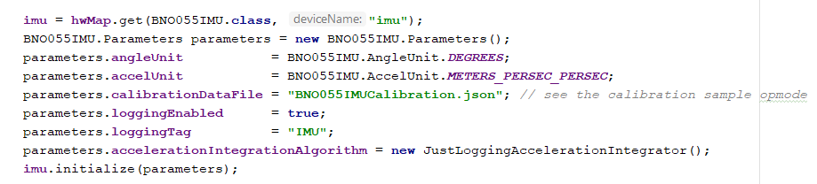
Now lets do it properly (ish)
Disclaimer: This is based off of my previous experience and hasn’t been “taught” and as such may not be the most optimal method.
First we need to create a new hardware device, “public BNO055IMU imu;”
Like how we had to configure motors, we need to do the same for the gyro.

Slide 8
How to access heading

Slide 9
How should we integrate this into our Autonomous
Time for some control theory YAY!

Slide 10
Bang-Bang Control
4613
90 degrees
Goal
Error = 90 degrees
Turn at full speed until error = 0
If error < 0
Turn at full speed in the other direction
What are the benefits and flaws of this system?

Slide 11
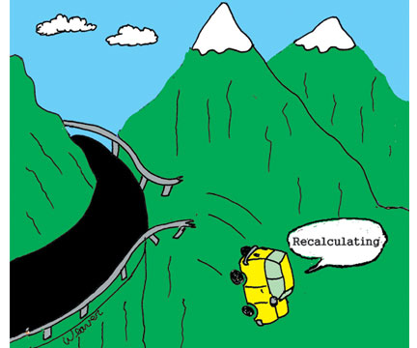
So how do we slow down in time so that we don’t overshoot the goal?

Slide 12
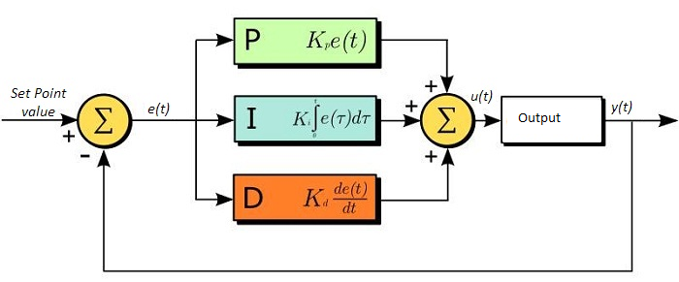
PID control
Proportional – a proportional response to the error
Integral- a cumulative response to the error
Derivative – a predictive response to the error based on the rate of change
I is useful for fixing ‘steady-state-error’ – when the output is slightly off, but not enough for P to manage to move it (due to things such as friction – I builds up untill it makes it move.

Slide 13
PID Control
The three sections (PI&D)
However, before they are summed each section is multiplied by a special value.
These values are the three constants K_{p} , K_{I} & K_{D}
These values are different for every system, because each system responds differently – with different amounts of lag, momentum, units and energy
These values are found through the process of tuning – essentially trial and error
This can be done with things other than Gyro, e.g. encoders.
Heavily used in the industry

Slide 14
Activity:
Try and program the robot to smoothly turn from a heading of 0 degrees to a heading of 90 degrees using PID control.
*Note: if your target is 5 degrees and your position is 285 degrees, you need to factor this in to make sure that you turn in the most optimal direction.
Write code where in teleop your turn adjusts the desired heading of the robot and then the robot will drive straight until you change it again (not recommending exactly for competition. More as an interesting exercise.

